Slide 1
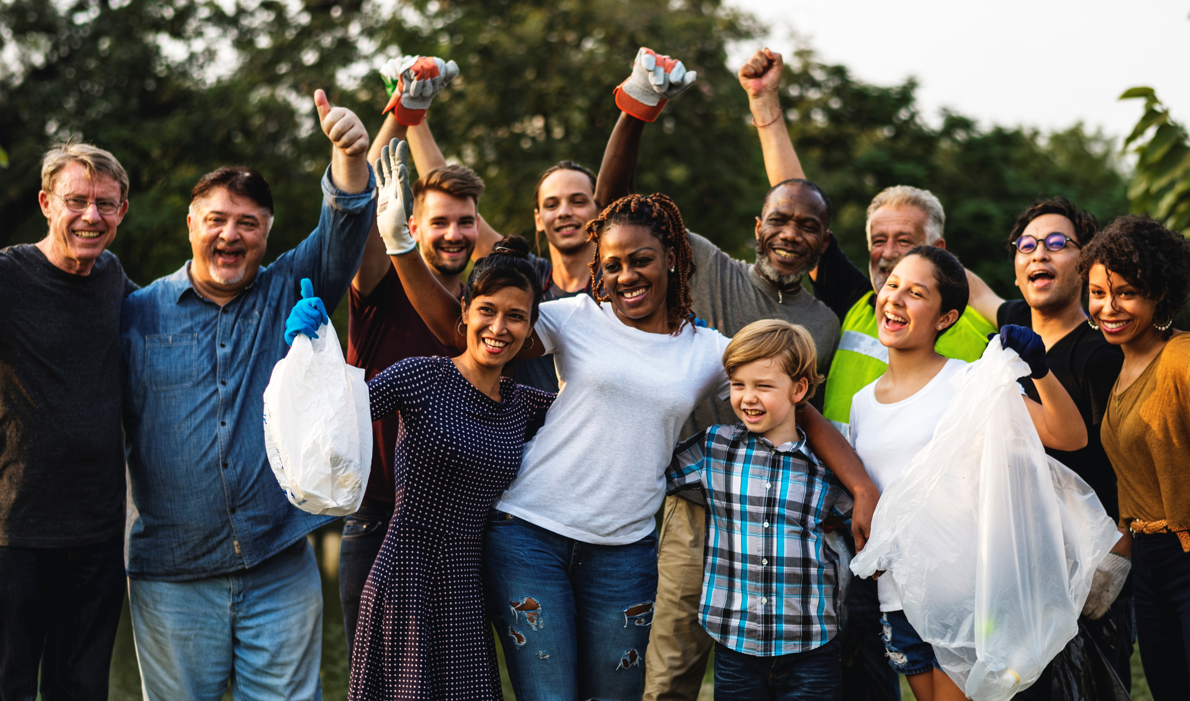

An Overview

Slide 2
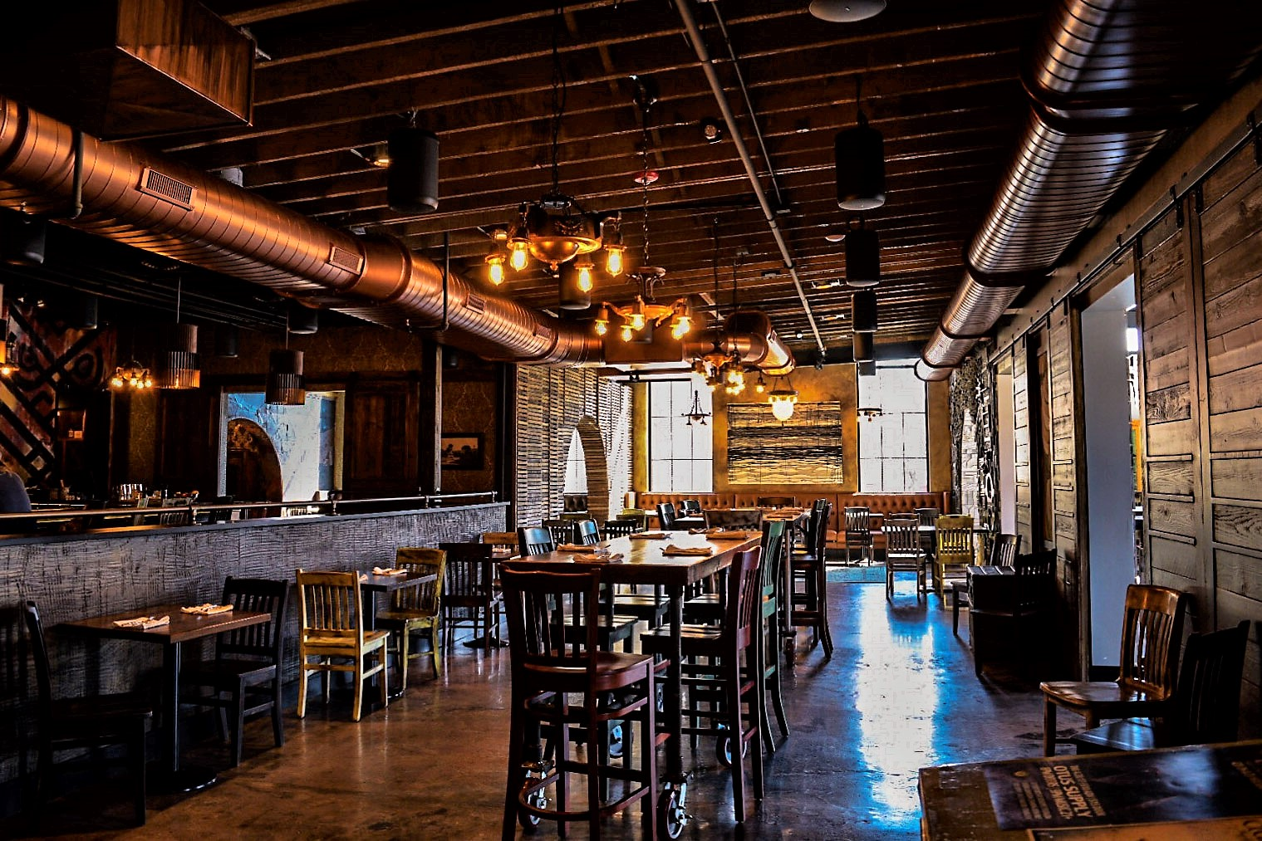
You want to grow your business.
But how do you get people
to give you a try?

Slide 3

Offering rewards is a proven way to
get people in your door… until they’re hooked!

Slide 4

Unfortunately, creating and managing a successful rewards program takes a lot of work.
Time-consuming to create and manage
Finding sponsors is challenging
People want easy technology and lots of choices
Participating in multiple reward programs for multiple organizations is CONFUSING
People want a PURPOSE

Slide 5
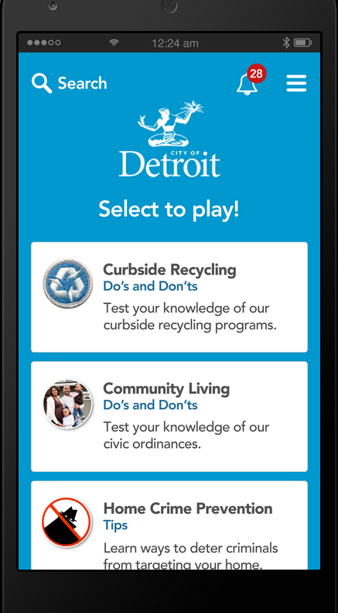
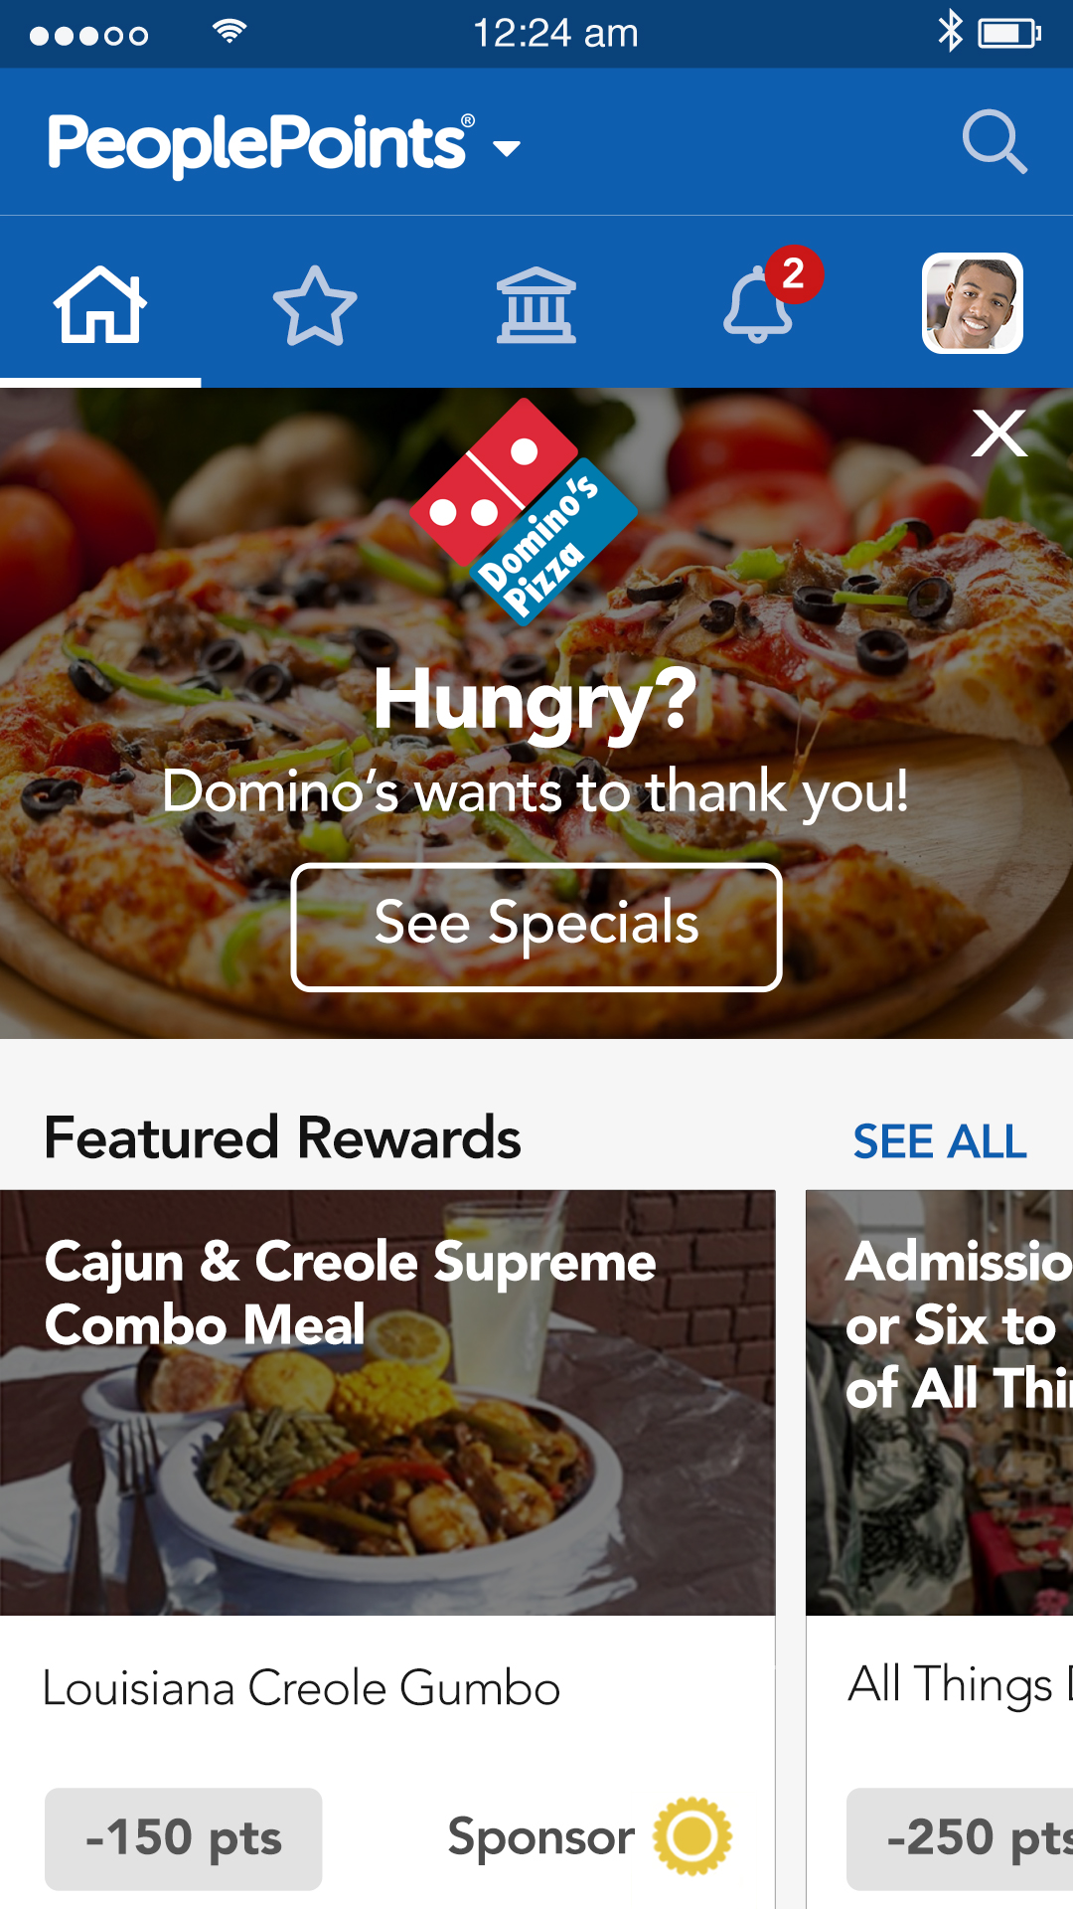


Our Solution: Engage customers with PeoplePoints® Rewards!
Create a Rewards Program at MyPeoplePoints.com for your city, nonprofit, or business
Citizens earn points as they take quizzes, volunteer and other activities from you and your partners
Citizens redeem points for goods & services from participating businesses or donate to a cause or nonprofit

Slide 6


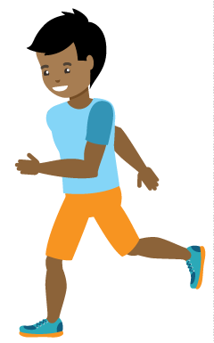

PeoplePoints® helps you grow as you help your community
4. Businesses reuse points for incentives or donate to cities & organizations
1. Cities & organizations buy or receive points for rewards programs
3. Users redeem points for rewards from businesses
2. Citizens and members earn points through community activities

Slide 7
PeoplePoints® will increase response…
Brand actions on social media that prompt consumers to purchase/act
Being responsive
48%
Offering Promotions
46%
Providing educational content
42%
Sharing interesting visuals
38%
Being funny
36%
Offering exclusive content
35%
Providing behind the scenes content
27%
Trash talking competing brands
10%
Source: sproutsocial.com (Q2 2017)

Slide 8
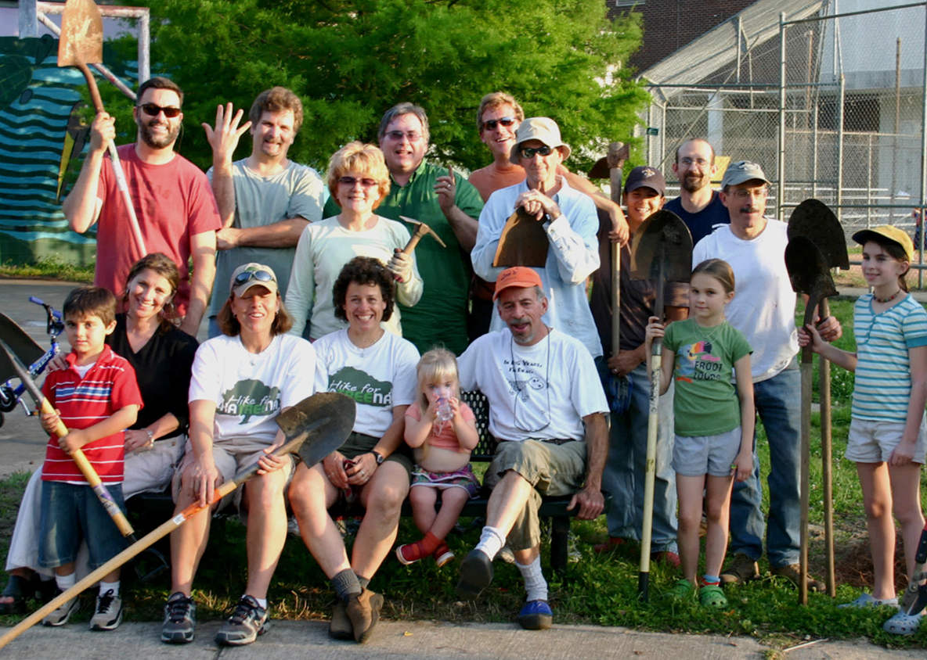
… and reduce campaign “Cost per Action”.
Initiatives have budgets or ongoing expenses for community outreach & engagement (the “Cost”)
The goal is to have citizens, students & employees
respond (the “Action”)
The “Cost per Action” is
the average cost per
response achieved

Slide 9
Examples of customer uses
GOVERNMENTS
NONPROFITS & FOUNDATIONS
UNIVERSITIES
& SCHOOLS
COMPANIES & LOCAL BUSINESS
Emergency Planning
Healthy Living
Campus Safety
Promote Business
Local Business
Attend Events
Volunteering
Employee Wellness
Visitors & Tourism
Volunteering
Tutoring
Community CSR
Citizen Engagement
Outcomes Tracking
Fund Raising
Wellness Seminars

Slide 10
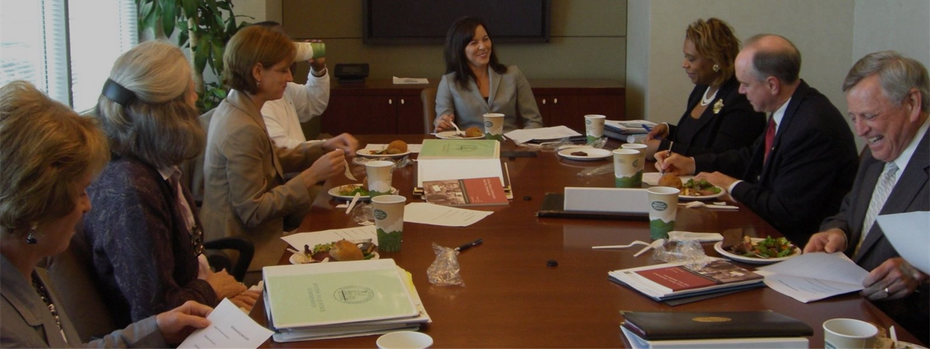
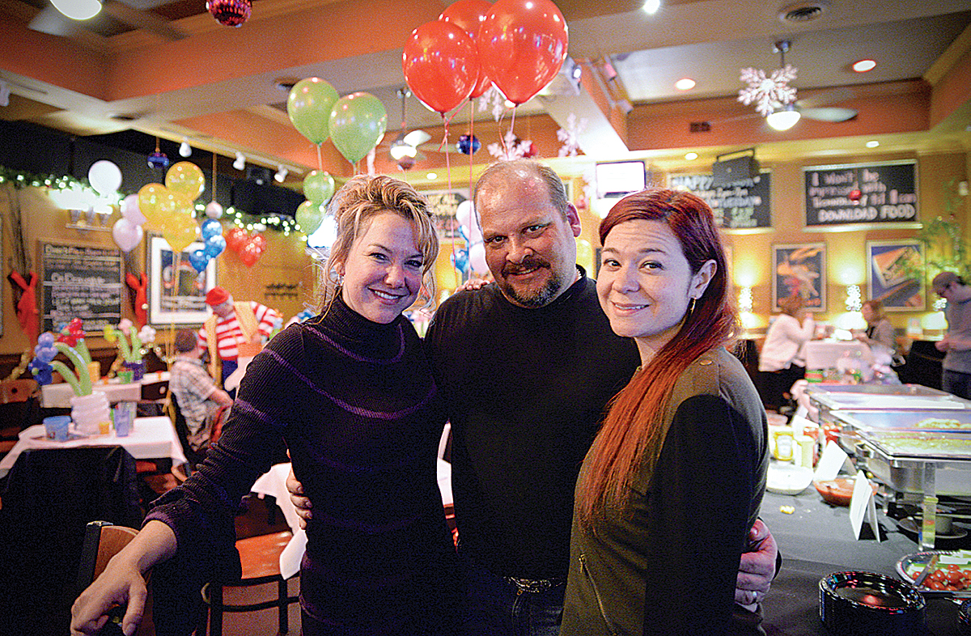
Supporting community leaders is good for business.
Nonprofit, civic leaders, doctors, board members & concerned citizens are the community “Influentials”
They are most trusted when it comes to voting, shopping and what to do
Local small businesses need to unleash their ‘word of mouth’ influence
Support community Influentials and they’ll help you grow!
– The Influentials, Keller and Berry, RoperUSA

Slide 11
You’ll reach these key “Influentials” with PeoplePoints®
Elected & Career
Governmental Officials
Corporate Executives
Public Relations &
Communications Professionals
School Districts & Universities
Hospitals & Health Care
Companies
Real Estate Developers & Management Companies
Doctors & Dentists
Houses of Worship & Clergy
Corporate Governmental
Relations
Foundation, Nonprofit
& Grassroots Leaders
Small Business Owners & Entrepreneurs
Young Professionals

Slide 12
How It Works
Sign up
for FREE
Accept Points for Rewards
Transaction
Fee
Donate or Reuse Points
Easy for businesses, customers & citizens to join
We’ll help businesses start with a few items and suggest point values and redemption limits
A 5% fee is deducted when points are redeemed
As points add up, donate them to an organization or use them for your promotions

Slide 13
Participating in PeoplePoints® Rewards is easy!
  Create your city, organization or business Rewards Program at MyPeoplePoints.com and “join” our rewards program
  We’ll help create and post the rewards for your organization with a redemption process that works for you
  We’ll help train your employees on how to redeem points
  You accept points from customers
  Promote your program to your members and customers at your places of business, mailing lists and social media!

Slide 14
Outcomes
Initiative participation & impact will SKYROCKET
Leaders
will thank YOU for helping them succeed
Your information
will REACH key leaders & citizens
Our network will receive emails weekly featuring YOU
Community social capital & business profits will INCREASE
You’ll have tons of PeoplePoints® to promote your offerings,
give rewards and donate to local community partners!

Slide 15

The more people are rewarded for doing good,
the more they’ll do it, the stronger your community
will be, and the more customers will LOVE YOU!
Need help?
Email support@peoplemovers.com
© 2020 PeopleApps, Inc. All Rights Reserved

